Slide 1
Ensemble learning
David Kauchak
CS158 – Fall 2023

Slide 2
Admin
Assignment 9
Midterm 2
Final project proposals due today!
Office hours this week
Wednesday: 3:15-4pm
Thursday: 3:30-4:30pm

Slide 3
Quick exercise
Write down on the paper (don’t write your name):
Something you’re happy about right now
Something you’re worried about right now
Fold the piece of paper
I’ll collect them, redistribute them and we’ll read them out loud
If you don’t want to participate, just leave the paper blank

Slide 4
Ensemble learning
Basic idea: if one classifier works well, why not use multiple classifiers!

Slide 5
Ensemble learning
Basic idea: if one classifier works well, why not use multiple classifiers!
Training
learning alg
model 1
learning alg
model 2
Training
Data
…
learning alg
model m

Slide 6
Ensemble learning
Basic idea: if one classifier works well, why not use multiple classifiers!
Testing
model 1
prediction 1
example to label
model 2
prediction 2
How do we decide on the final prediction?
…
model m
prediction m

Slide 7
Ensemble learning
Basic idea: if one classifier works well, why not use multiple classifiers!
Testing
prediction 1
take majority vote
if they output probabilities, take a weighted vote
prediction 2
…
How does having multiple classifiers help?
prediction m

Slide 8
Benefits of ensemble learning
Assume each classifier makes a mistake with some probability (e.g. 0.4, that is a 40% error rate)
model 1
Assuming the decisions made between classifiers are independent, what will be the probability that we make a mistake (i.e. error rate) with three classifiers for a binary classification problem?
model 2
model 3

Slide 9
Benefits of ensemble learning
Assume each classifier makes a mistake with some probability (e.g. 0.4, that is a 40% error rate)
model 1 | model 2 | model 3 | prob
C | C | C | .6*.6*.6=0.216
C | C | I | .6*.6*.4=0.144
C | I | C | .6*.4*.6=0.144
C | I | I | .6*.4*.4=0.096
I | C | C | .4*.6*.6=0.144
I | C | I | .4*.6*.4=0.096
I | I | C | .4*.4*.6=0.096
I | I | I | .4*.4*.4=0.064

Slide 10
Benefits of ensemble learning
Assume each classifier makes a mistake with some probability (e.g. 0.4, that is a 40% error rate)
model 1 | model 2 | model 3 | prob
C | C | C | .6*.6*.6=0.216
C | C | I | .6*.6*.4=0.144
C | I | C | .6*.4*.6=0.144
C | I | I | .6*.4*.4=0.096
I | C | C | .4*.6*.6=0.144
I | C | I | .4*.6*.4=0.096
I | I | C | .4*.4*.6=0.096
I | I | I | .4*.4*.4=0.064
0.096+
0.096+
0.096+
0.064 =
35% error!

Slide 11
Benefits of ensemble learning
3 classifiers in general, for r = probability of mistake for individual classifier:
binomial distribution
r | p(error)
0.4 | 0.35
0.3 | 0.22
0.2 | 0.10
0.1 | 0.028
0.05 | 0.0073

Slide 12
Benefits of ensemble learning
5 classifiers in general, for r = probability of mistake for individual classifier:
r | p(error) 3 classifiers | p(error) 5 classifiers
0.4 | 0.35 | 0.32
0.3 | 0.22 | 0.16
0.2 | 0.10 | 0.06
0.1 | 0.028 | 0.0086
0.05 | 0.0073 | 0.0012

Slide 13
Benefits of ensemble learning
m classifiers in general, for r = probability of mistake for individual classifier:
(cumulative probability distribution for the binomial distribution)

Slide 14
Given enough classifiers…
r = 0.4
number of classifiers

Slide 15
What’s the catch?
Assume each classifier makes a mistake with some probability (e.g. 0.4, that is a 40% error rate)
model 1
Assuming the decisions made between classifiers are independent, what will be the probability that we make a mistake (i.e. error rate) with three classifiers for a binary classification problem?
model 2
model 3

Slide 16
What’s the catch?
Assume each classifier makes a mistake with some probability (e.g. 0.4, that is a 40% error rate)
model 1
Assuming the decisions made between classifiers are independent, what will be the probability that we make a mistake (i.e. error rate) with three classifiers for a binary classification problem?
model 2
model 3

Slide 17
Obtaining independent classifiers
learning alg
model 1
learning alg
model 2
Training
Data
…
learning alg
model m
Where do we get m independent classifiers?

Slide 18
Idea 1: different learning methods
model 1
decision tree
learning alg
k-nn
learning alg
model 2
Training
Data
perceptron
…
naïve bayes
model m
gradient descent variant 1
learning alg
gradient descent variant 2
Pros/cons?
…

Slide 19
Idea 1: different learning methods
Pros:
Lots of existing classifiers already
Can work well for some problems
Cons/concerns:
Often, classifiers are not independent, that is, they make the same mistakes!
e.g. many of these classifiers are linear models
voting won’t help us if they’re making the same mistakes

Slide 20
Idea 2: split up training data
part 1
learning alg
model 1
part 2
learning alg
model 2
Training
Data
…
…
part m
learning alg
model m
Use the same learning algorithm, but train on different parts of the training data

Slide 21
Idea 2: split up training data
Pros:
Learning from different data, so can’t overfit to same examples
Easy to implement
fast
Cons/concerns:
Each classifier is only training on a small amount of data
Not clear why this would do any better than training on full data and using good regularization

Slide 22
Idea 3: bagging
Training
Data 1
learning alg
model 1
…
Training
Data
…
learning alg
model m
Training
Data m

Slide 23



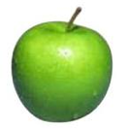
data generating distribution
Training data
Test set
data generating distribution

Slide 24
Ideal situation
Training data 1
Training data 2
…
data generating distribution
Notes:
but we can’t do this ☹

Slide 25
bagging
“Training” data 1
“Training” data 2
…
Training data
Use training data as a proxy for the data generating distribution
Notes:
pretend like the training data defines out data generating distribution
sample with replacement to generate new “training” data sets

Slide 26
sampling with replacements
“Training” data 1
Training data

Slide 27
sampling with replacements
“Training” data 1
pick a random example from the real training data
Training data

Slide 28
sampling with replacements
“Training” data 1
add it to the new “training” data
Training data

Slide 29
sampling with replacements
“Training” data 1
put it back (i.e. leave it) in the original training data
Training data

Slide 30
sampling with replacements
“Training” data 1
pick another random example
Training data

Slide 31
sampling with replacements
“Training” data 1
pick another random example
Training data

Slide 32
sampling with replacements
“Training” data 1
keep going until you’ve created a new “training” data set
Training data

Slide 33
bagging
create m “new” training data sets by sampling with replacement from the original training data set (called m “bootstrap” samples)
train a classifier on each of these data sets
to classify, take the majority vote from the m classifiers

Slide 34
bagging concerns
Training
Data 1
Won’t these all be basically the same?
Training
Data
…
Training
Data m

Slide 35
bagging concerns
For a data set of size n, what is the probability that a given example will NOT be select in a “new” training set sampled from the original?
Training data

Slide 36
bagging concerns
What is the probability it isn’t chosen the first time?
Training data

Slide 37
bagging concerns
What is the probability it isn’t chosen the any of the n times?
Each draw is independent and has the same probability
Training data

Slide 38
probability of overlap
p(not chosen)
Converges very quickly to 1-1/e ≈ 37%

Slide 39
bagging overlap
Training
Data 1
Won’t these all be basically the same?
Training
Data
…
On average, a randomly sampled data set will only contain 63% of the examples in the original
Training
Data m

Slide 40
When does bagging work
Let’s say 10% of our examples are noisy (i.e. don’t provide good information)
For each of the “new” data set, what proportion of noisy examples will they have?
They’ll still have ~10% of the examples as noisy
However, these examples will only represent about two-thirds of the original noisy examples
For some classifiers that have trouble with noisy classifiers, this can help

Slide 41
When does bagging work
Bagging tends to reduce the variance of the classifier
By voting, the classifiers are more robust to noisy examples
Bagging is most useful for classifiers that are:
Unstable: small changes in the training set produce very different models
Prone to overfitting
Often has similar effect to regularization
Notes:
which methods that we’ve seen so far are more unstable?
decision trees

Slide 42
Idea 4: boosting
training data
“training” data 2
“training” data 3
Data
Label
Weight
Data
Label
Weight
Data
Label
Weight
0
0.2
0
0.1
0
0.05
0
0.2
0
0.1
0
0.2
1
0.2
1
0.4
1
0.2
1
0.2
1
0.1
1
0.05
0
0.2
0
0.3
0
0.5

Slide 43

“Strong” learner
Given
a reasonable amount of training data
a target error rate ε
a failure probability p
A strong learning algorithm will produce a classifier with error rate <ε with probability 1-p

Slide 44

“Weak” learner
Given
a reasonable amount of training data
a failure probability p
A weak learning algorithm will produce a classifier with error rate < 0.5 with probability 1-p
Weak learners are much easier to create!

Slide 45
weak learners for boosting
Data
Label
Weight
0
0.2
0
0.2
weak learning algorithm
weak classifier
1
0.2
1
0.2
Which of our algorithms can handle weights?
0
0.2
Need a weak learning algorithm that can handle weighted examples

Slide 46
boosting: basic algorithm
Training:
start with equal example weights
for some number of iterations:
learn a weak classifier and save
change the example weights
Classify:
get prediction from all learned weak classifiers
weighted vote based on how well the weak classifier did when it was trained (i.e. in relation to training error)

Slide 47
boosting basics
Start with equal weighted examples
Weights:
Examples:
E1
E2
E3
E4
E5
Learn a weak classifier:
weak 1

Slide 48
Boosting
classified correct
classified incorrect
Weights:
Examples:
E1
E2
E3
E4
E5
We want to reweight the examples and then learn another weak classifier
How should we change the example weights?
weak 1

Slide 49
Boosting
Weights:
Examples:
E1
E2
E3
E4
E5
decrease the weight for those we’re getting correct
increase the weight for those we’re getting incorrect

Slide 50
Boosting
Weights:
Examples:
E1
E2
E3
E4
E5
Learn another weak classifier:
weak 2

Slide 51
Boosting
Weights:
Examples:
E1
E2
E3
E4
E5
weak 2

Slide 52
Boosting
Weights:
Examples:
E1
E2
E3
E4
E5
decrease the weight for those we’re getting correct
increase the weight for those we’re getting incorrect

Slide 53
Classifying
weak 1
prediction 1
weighted vote based on how well they classify the training data
weak 2
prediction 2
weak_2_vote > weak_1_vote since it got more right
…

Slide 54
Notation
x_{i} example i in the training data
w_{i} weight for example i, we will enforce:
classifier_{k}(x_{i}) +1/-1 prediction of classifier k example i

Slide 55
AdaBoost: train
for k = 1 to iterations:
classifier_{k} = learn a weak classifier based on weights
calculate weighted error for this classifier
calculate “score” for this classifier:
change the example weights

Slide 56
AdaBoost: train
classifier_{k} = learn a weak classifier based on weights
weighted error for this classifier is:
What does this say?

Slide 57
AdaBoost: train
classifier_{k} = learn a weak classifier based on weights
weighted error for this classifier is:
What is the range of possible values?
prediction
did we get the example wrong
weighted sum of the errors/mistakes

Slide 58
AdaBoost: train
classifier_{k} = learn a weak classifier based on weights
weighted error for this classifier is:
Between 0 (if we get all examples right) and 1 (if we get them all wrong)
prediction
did we get the example wrong
weighted sum of the errors/mistakes

Slide 59
AdaBoost: train
classifier_{k} = learn a weak classifier based on weights
“score” or weight for this classifier is:
What does this look like (specifically for errors between 0 and 1)?

Slide 60
AdaBoost: train
ranges from +∞ to -∞
for most reasonable values: ranges from 1 to -1
errors of 50% = 0
error < 50% = positive error > 50% = negative

Slide 61
AdaBoost: classify
What does this do?

Slide 62
AdaBoost: classify
The weighted vote of the learned classifiers weighted by α (remember α generally varies from 1 to -1 training error)
What happens if a classifier has error >50%

Slide 63
AdaBoost: classify
The weighted vote of the learned classifiers weighted by α (remember α generally varies from 1 to -1 training error)
We vote the opposite!

Slide 64
AdaBoost: train, updating the weights
update the example weights
Remember, we want to enforce:
Z is called the normalizing constant. It is used to make sure that the weights sum to 1
What should it be?

Slide 65
AdaBoost: train
update the example weights
Remember, we want to enforce:
normalizing constant (i.e. the sum of the “new” w_{i}):

Slide 66
AdaBoost: train
update the example weights
What does this do?

Slide 67
AdaBoost: train
update the example weights
correct positive
incorrect negative
correct
incorrect
?

Slide 68
AdaBoost: train
update the example weights
correct positive
incorrect negative
correct small value
incorrect large value
Note: only change weights based on current classifier (not all previous classifiers)

Slide 69
AdaBoost: train
update the example weights
What does the α do?

Slide 70
AdaBoost: train
update the example weights
What does the α do?
If the classifier was good (<50% error) α is positive:
trust classifier output and move as normal
If the classifier was bad (>50% error) α is negative
classifier is so bad, consider opposite prediction of classifier

Slide 71
AdaBoost: train
update the example weights
correct positive
incorrect negative
correct small value
incorrect large value
If the classifier was good (<50% error)α is positive
If the classifier was back (>50% error)α is negative

Slide 72
AdaBoost justification
update the example weights
Does this look like anything we’ve seen before?

Slide 73
AdaBoost justification
update the example weights
Exponential loss!
AdaBoost turns out to be another approach for minimizing the exponential loss!

Slide 74
Other boosting variants
Adaboost =
Logitboost
Loss
Brownboost
0-1 loss
loss
Mistakes
Correct
Notes:
- many other “boosting” variants besides AdaBoost that can all be equated to different surrogate loss functions

Slide 75
Boosting example
Start with equal weighted data set

Slide 76
Boosting example
weak learner = line
What would be the best line learned on this data set?
h => p(error) = 0.5 it is at chance

Slide 77
Boosting example
How should we reweight examples?
This one seems to be the best
This is a ‘weak classifier’: It performs slightly better than chance.

Slide 78
Boosting example
What would be the best line learned on this data set?
reds on this side get less weight
blues on this side get more weight
reds on this side get more weight
blues on this side get less weight

Slide 79
Boosting example
How should we reweight examples?

Slide 80
Boosting example
What would be the best line learned on this data set?

Slide 81
Boosting example

Slide 82
Boosting example
f₁
f₂
f₄
f₃
The strong (non- linear) classifier is built as the combination of all the weak (linear) classifiers.

Slide 83
AdaBoost: train
for k = 1 to iterations:
classifier_{k} = learn a weak classifier based on weights
weighted error for this classifier is:
“score” or weight for this classifier is:
change the example weights
What can we use as a classifier?
Notes:
- what can we use as a classifier?

Slide 84
AdaBoost: train
for k = 1 to iterations:
classifier_{k} = learn a weak classifier based on weights
weighted error for this classifier is:
“score” or weight for this classifier is:
change the example weights
Anything that can train on weighted examples
For most applications, must be fast!
Why?
Notes:
- what can we use as a classifier?

Slide 85
AdaBoost: train
for k = 1 to iterations:
classifier_{k} = learn a weak classifier based on weights
weighted error for this classifier is:
“score” or weight for this classifier is:
change the example weights
Anything that can train on weighted examples
For most applications, must be fast!
Each iteration we have to train a new classifier
Notes:
- what can we use as a classifier?

Slide 86
Boosted decision stumps
One of the most common classifiers to use is a decision tree:
can use a shallow (2-3 level tree)
even more common is a 1-level tree
called a decision stump ☺
asks a question about a single feature
What does the decision boundary look like for a decision stump?

Slide 87
Boosted decision stumps
One of the most common classifiers to use is a decision tree:
can use a shallow (2-3 level tree)
even more common is a 1-level tree
called a decision stump ☺
asks a question about a single feature
What does the decision boundary look like for boosted decision stumps?

Slide 88
Boosted decision stumps
One of the most common classifiers to use is a decision tree:
can use a shallow (2-3 level tree)
even more common is a 1-level tree
called a decision stump ☺
asks a question about a single feature
Linear classifier!
Each stump defines the weight for that dimension
If you learn multiple stumps for that dimension then it’s the weighted average

Slide 89
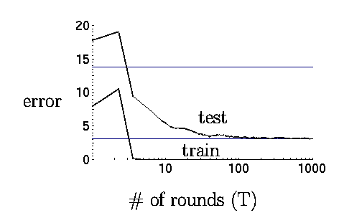
Boosting in practice
Very successful on a wide range of problems
One of the keys is that boosting tends not to overfit, even for a large number of iterations
Using <10,000 training examples can fit >2,000,000 parameters!

Slide 90
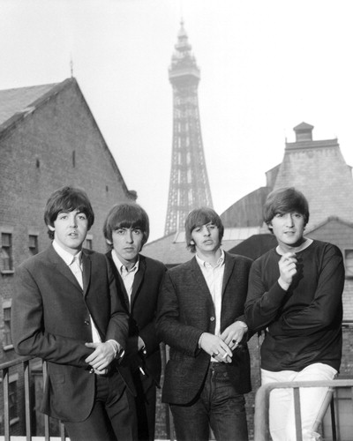
Adaboost application example: face detection

Slide 91
Adaboost application example: face detection

Slide 92
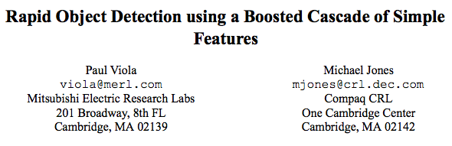
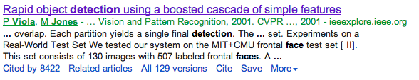

Slide 93
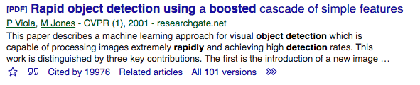

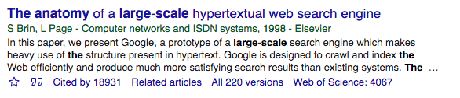
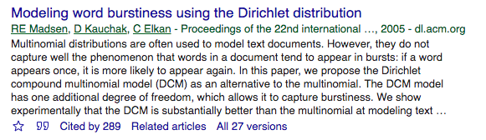
To give you some context of importance:
or:

Slide 94
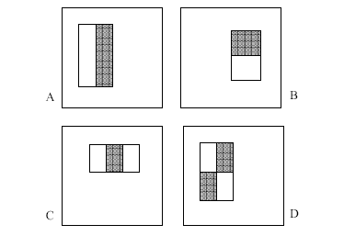
“weak” learners
4 Types of “Rectangle filters” (Similar to Haar wavelets
Papageorgiou, et al. )
Based on 24x24 grid: 160,000 features to choose from
g(x) =
sum(WhiteArea) - sum(BlackArea)

Slide 95
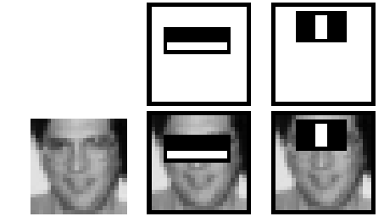
“weak” learners
F(x) = α₁ f₁(x) + α₂ f₂(x) + ...
1 if g_{i}(x) > θ_{i}
-1 otherwise
f_{i}(x) =

Slide 96
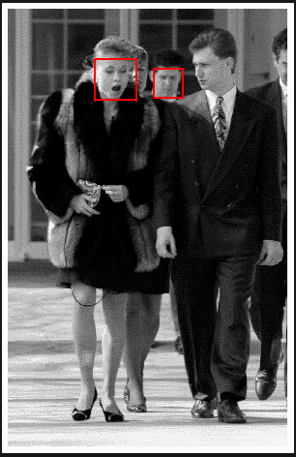
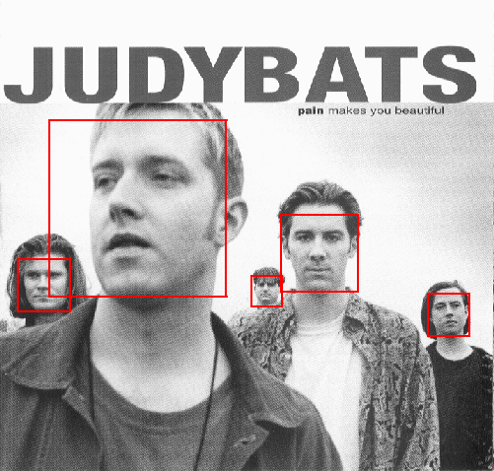
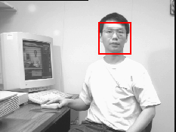
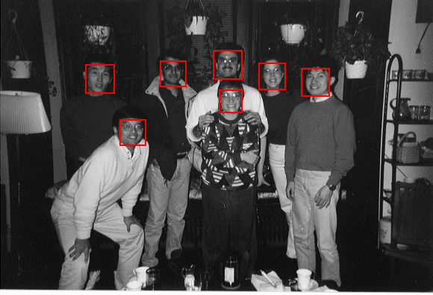
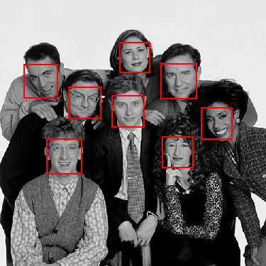
Example output

Slide 97
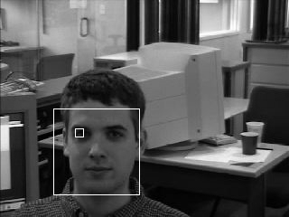
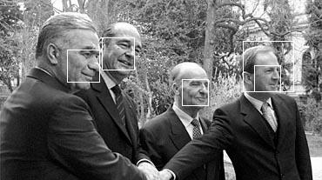
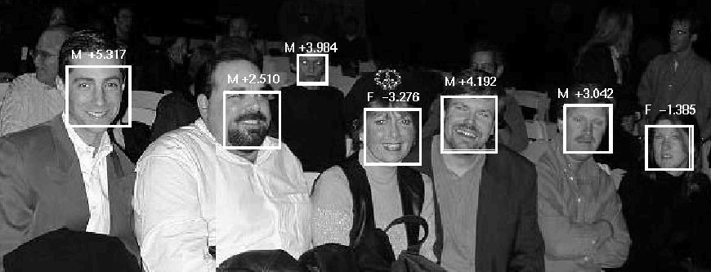
Solving other “Face” Tasks
Facial Feature Localization
Profile Detection
Demographic
Analysis

Slide 98

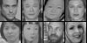
“weak” classifiers learned

Slide 99
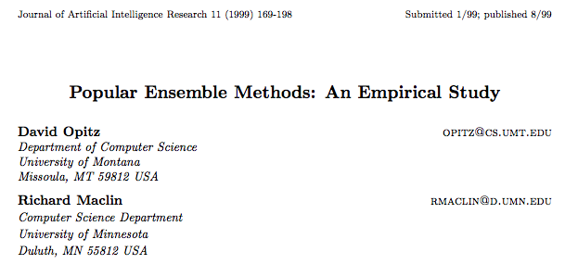
Bagging vs Boosting
http://arxiv.org/pdf/1106.0257.pdf

Slide 100
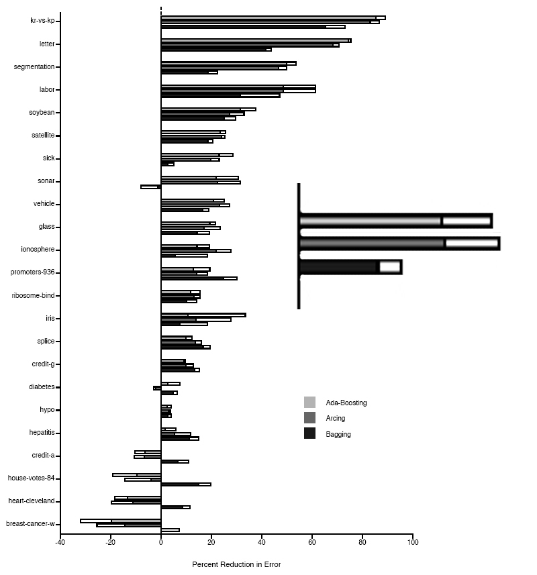
Boosting Neural Networks
Change in error rate over standard classifier
Ada-Boosting
Arcing
Bagging
White bar represents 1
standard deviation

Slide 101
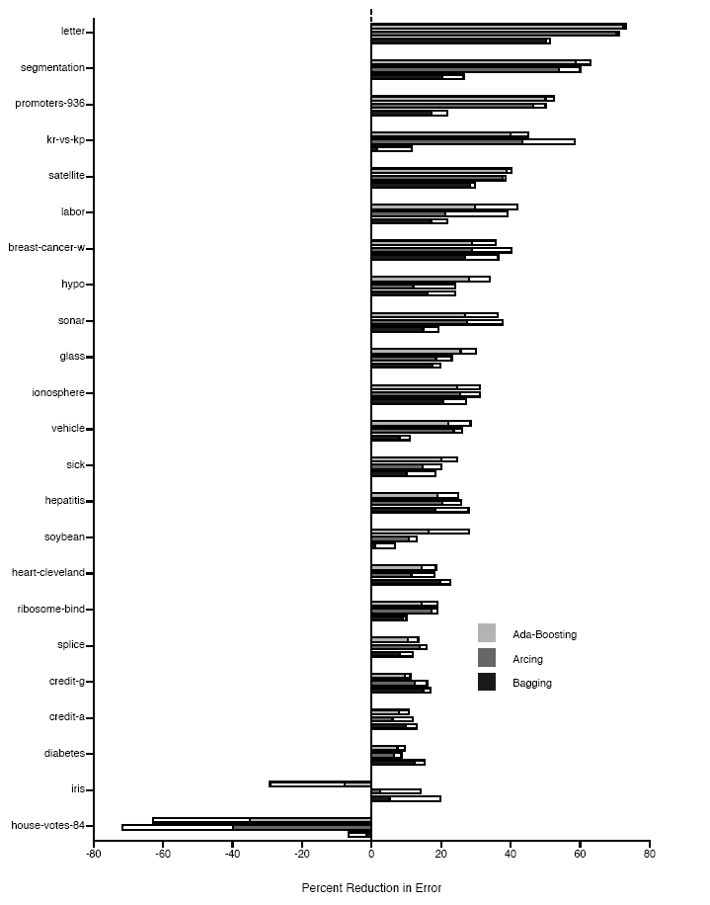
Boosting Decision Trees

